Slide 2
General Social Competence (18)
-0.22*
Friendships
Parental Psychological Control (Age 13)
-0.18*
Companionship and Recreation (18)
-0.26**
-.24**
Conflict Resolution (18)
-0.26**
Teen Positive Autonomy and Relatedness (18)
-.36**
Best Friend Positive
Autonomy and Relatedness (18)
Parental Firm Control
(Age 13)
Romantic Relationships
Teen Positive Autonomy and Relatedness (21)
Romantic Partner Positive Autonomy and Relatedness (21)

Slide 3
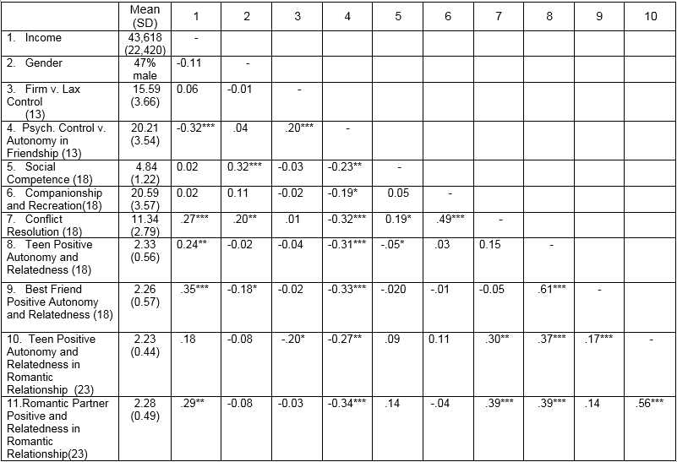
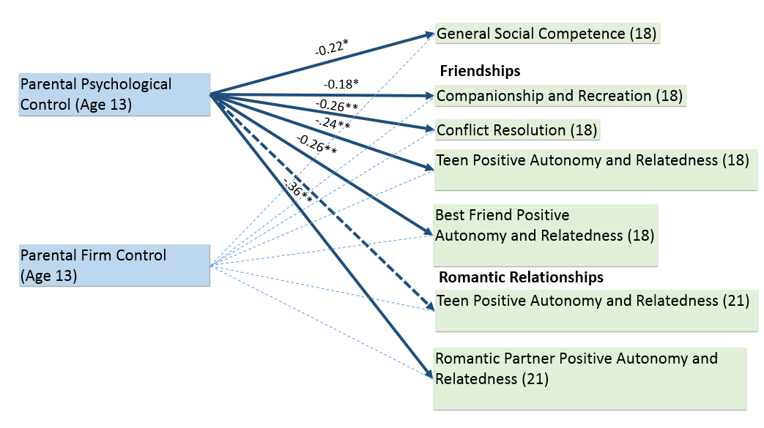
Parental Psychological and Behavioral Control as Predictors of Late Adolescent Peer and Romantic Relationships
Emily A. Smith and David E. Szwedo James Madison University
Introduction
Measures
Childhood Report of Parenting Behavior (age 13) Teens evaluated their perceptions of psychological control vs. autonomy as well as firm versus lax behavioral control from their mothers. Items were scored on a three-point scale, with higher scores indicating greater psychological and firm behavioral control and lower scores indicating greater autonomy promoting behavior and lax behavioral control, respectively.
Adolescent Problem Inventory (ages 13 & 18) Social competence was assessed through teen’s responses to social problem solving scenarios. Higher scores indicated a greater likelihood that teens thought that they could make a competent response to a given social situation.
Autonomy & Relatedness Behaviors (ages 13 & 18 for teens and best friends; 18 and 21 for teens and romantic partners) Autonomy and relatedness behaviors were assessed during a 6-minute observed revealed-differences interaction task with teens and their best friends and teens and their romantic partners. Teens’ and friends’/partners’ behavior were coded for autonomy (e.g. giving reasoned arguments for their position) and relatedness (e.g. demonstrations of caring/warmth).
Friendship Quality Questionnaire (ages 13 & 18) Teen’s perceptions of companionship and conflict resolution were assessed with a self-report questionnaire of adolescent’s friendship quality. Items were scored on a 5-point Likert scale, with higher scores indicating greater companionship and better conflict resolution.
Table 1. Univariate statistics and intercorrelations between primary constructs
Psychological control refers to parental behaviors that are intrusive and manipulative of children’s thoughts, feelings, and attachments to parents. These behaviors appear to be associated with disturbances in psychoemotional boundaries between the child and parent, and hence with the development of an independent sense of self and identity. It is also predictive of numerous forms of psychological and social maladaptation (Barber, 2002).
Authoritative parenting is a mixture of permissive and authoritarian styles of parenting. Authoritative parenting allows autonomy and free-will with the reasoning and guidance towards future conduct (Baumrind, 1966).
The importance of a good social relationship and social competence is to develop a strong conflict resolution and self-concept which can be applicable in almost any given situation.
The purpose of this study is to examine the effects of parental firm vs. lax behavioral control and psychological control vs. autonomy promoting behaviors on individual development via the quality of their social relationships as well as social competence.
Figure 1. Heuristic representation of regression models predicting later social outcomes from earlier psychological control and firm control from parents.
Hypotheses
Results
Greater psychological control exercised by parents will predict a relative decrease in social competence, friendship quality, and autonomy and relatedness in friendships and romantic relationships.
Greater firm behavioral control exercised by parents will predict a relative decrease in social competence, friendship quality, and autonomy and relatedness in friendships and romantic relationships.
Psychological control and firm behavioral control will interact such that individuals’ whose parents display both greater levels of psychological control and firm behavioral control will have the most negative social outcomes.
Correlations between primary variables are presented in Table 1. Correlations suggested numerous negative associations between psychological control and social competence, friendship quality, and autonomy and relatedness behaviors. Firm behavioral control was only correlated with less positive autonomy and relatedness from teens toward their romantic partners.
Multiple regression analyses were conducted in order to determine the relative contributions of psychological control and firm behavioral control to later social outcomes. All analyses controlled for family income and participant gender, as well as a baseline measure of the outcome construct.
Analyses revealed that psychological control was a significant negative predictor of nearly all outcome variables, whereas firm behavioral control was not a significant predictor (see Figure 1).
Interactions between psychological control and firm behavioral control to predict study outcomes were also assessed. There were no significant interactions between psychological control and firm behavioral control.
*p ≤ .05
**p ≤ .01
Discussion
Adolescents who perceived their mothers to be more psychologically controlling experienced a relative decrease in social competence, friendship quality, and romantic relationship quality over time. Possibly due to views of a mother as a more relationally important figure.
Firm behavioral control did not emerge as a significant predictor of social functioning when considered alongside psychological control, highlighting the particularly damaging effects of psychologically controlling behavior
A particularly interesting consideration from these findings is that individuals may not only exhibit less positive behavior in their social relationships, but may also select partners who exhibit similarly low levels of positivity.
Method
Participants: N=184
Gender Race/ethnicity Income
86 males 107 Caucasian Median = $40,000 - $59,000
98 females 53 African American
24 Mixed/Other

