Slide 1
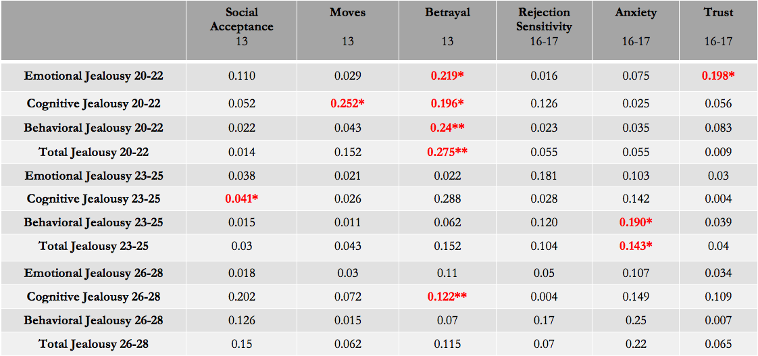
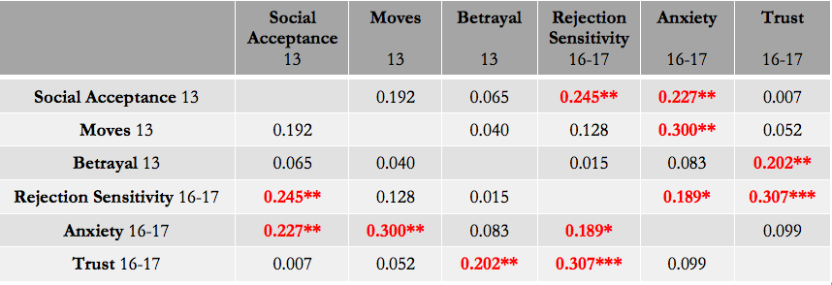
The Effects of Adolescent Social Experiences on Adult Romantic Jealousy
Jordan Gamache
James Madison University
Faculty Advisor: Dr. David Szwedo
Introduction
Social Acceptance, Rejection Sensitivity, and Jealousy
Young teens who are rated as “unpopular” on sociometric scales by their peers experience more social withdrawal, hostility, and negative emotions than their more “popular” peers (McElhaney et al, 2008 ).
Youth who report higher levels of loneliness and rejection sensitivity tend to experience more feelings of threat in their romantic relationships (Nowland, Talbot, & Qualter, 2018).
Residential Moves, Anxiety, and Jealousy
Moving during early adolescence predicts difficulty making friends, social distress, and lessened social contact (Scanlon & Devine, 2001).
Low-inclusionary status results in anxiety and jealousy in social situations (Leary, 1990)
Friend Betrayal, Trust, and Jealousy
When friend expectations are not met, it can cause a great deal of emotional stress, resulting in anger, sadness, and revenge goals (MacEvoy & Asher, 2012).
Lack of trust in social relationships can lead to suspicion and feelings of jealousy (Rodriguez et al, 2017).
Unpopularity
Age 13
Rejection Sensitivity
Ages 16-17
Emotional Jealousy
Ages 20-28
Anxiety
Ages 16-17
Vv
Residential Moves
Age 13
Cognitive Jealousy
Ages 20-28
Friend Betrayal
Age 13
Trust Issues
Ages 16-17
Behavioral Jealousy
Ages 20-28
Note. *=p<0.05, **=p<0.01, ***=p<0.001
Measures
Social Acceptance (age 13): Assessed using the social acceptance subscale of the Self-Perception profile for children, a self-report through responses on a 4-point Likert scale
Residential Moves (age 13): Assessed using the Residential Moves Questionnaire, a self-reported list of the number of moves from age 5
Friend Betrayal (age 13): Assessed using the conflict and betrayal subscale of the Friendship Quality Questionnaire, a self-report through responses on a 5-point Likert scale
Rejection Sensitivity (age 16-17): Assessed using the Rejection Sensitivity Questionnaire, a self- report using responses to fictitious social situations on a 6-point Likert scale
Anxiety (age 16-17): Assessed using the Beck Anxiety Inventory, a self-report of anxiety-related symptoms on a 4-point Likert scale
Trust (age 16-17): Assessed using the trust subscale of the Inventory of Parent and Peer Attachment, a self-report regarding their relationship with a close peer
Jealousy (age 20-28): Assessed using the Multidimensional Jealousy Scale, a 24-question self-report regarding jealous feelings toward the romantic partner.
Table 1: Correlations between predictors, mediators, and jealousy
Hypotheses
Adolescents who are viewed as unpopular in middle school will report a higher level of rejection sensitivity, leading to increased emotional jealousy in future romantic relationships.
Adolescents who experience residential moves in middle school will report higher levels of general anxiety, leading to increased cognitive jealousy in future relationships.
Adolescents who have experienced betrayal by a close friend in middle school will struggle with trust in peer relationships, leading to increased behavioral jealousy in future romantic relationships.
Note. *=p<0.05, **=p<0.01, ***=p<0.001
Table 2: Correlations between predictors and mediators
Discussion
These results were largely maintained when controlling for gender and income in regression analyses.
Unpopularity and residential moves may be similar mental and emotional experiences because of their correlation with anxiety and cognitive jealousy.
Friend betrayal is correlated with all dimensions of jealousy, suggesting its strong emotional effect.
These results demonstrate the importance of considering multiple early social factors across adolescence for understanding the development of jealousy in early adulthood.
Methods
Participants: 184 youth
98 female
107 Caucasian, 53 African American, 24 Mixed/Other
Median income $40,000-$59,000
Results
A number of significant correlations were found between adolescent social factors and later life romantic jealousy. Correlations between variables are presented in Tables 1 and 2.
Notes:
Discussion WHY

