Slide 1
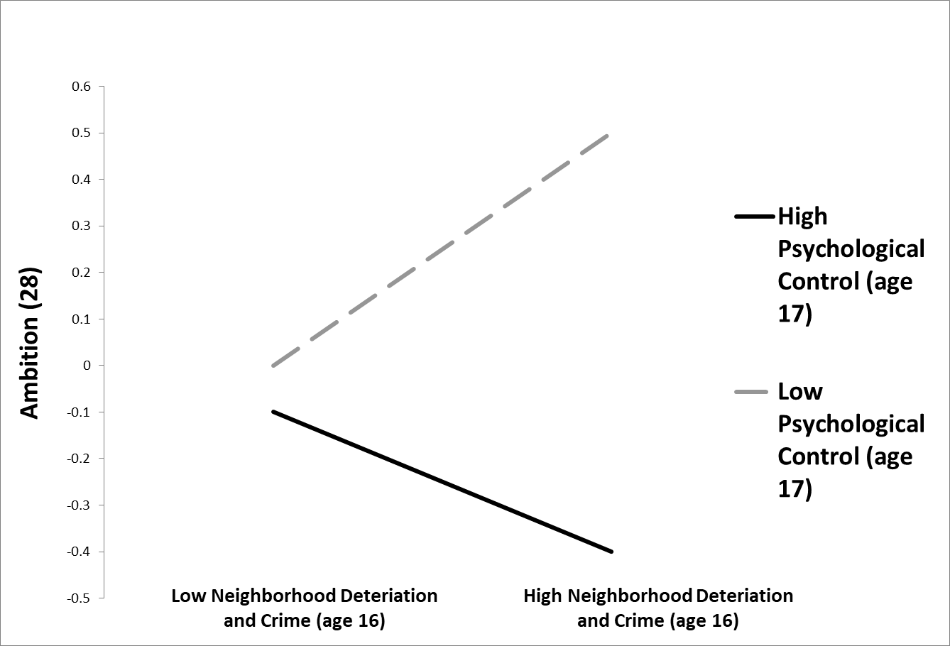
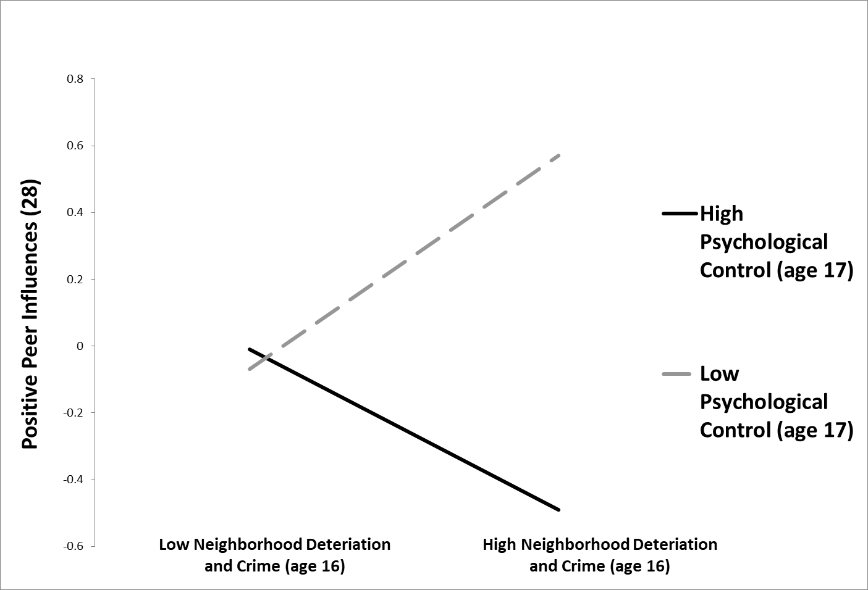
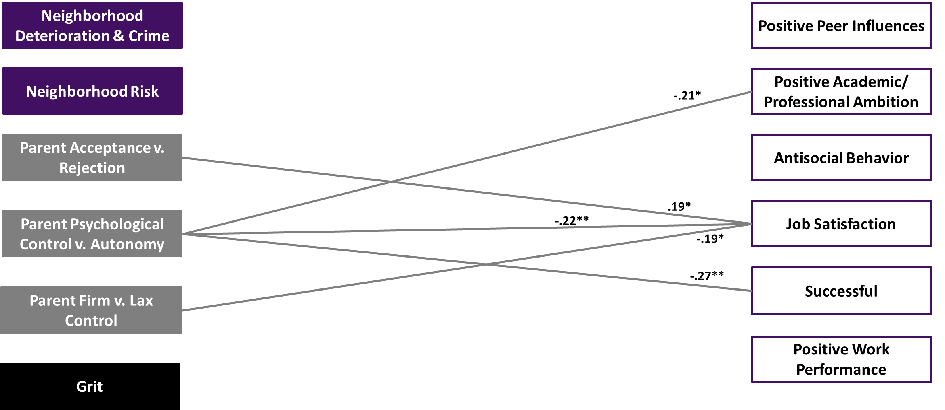
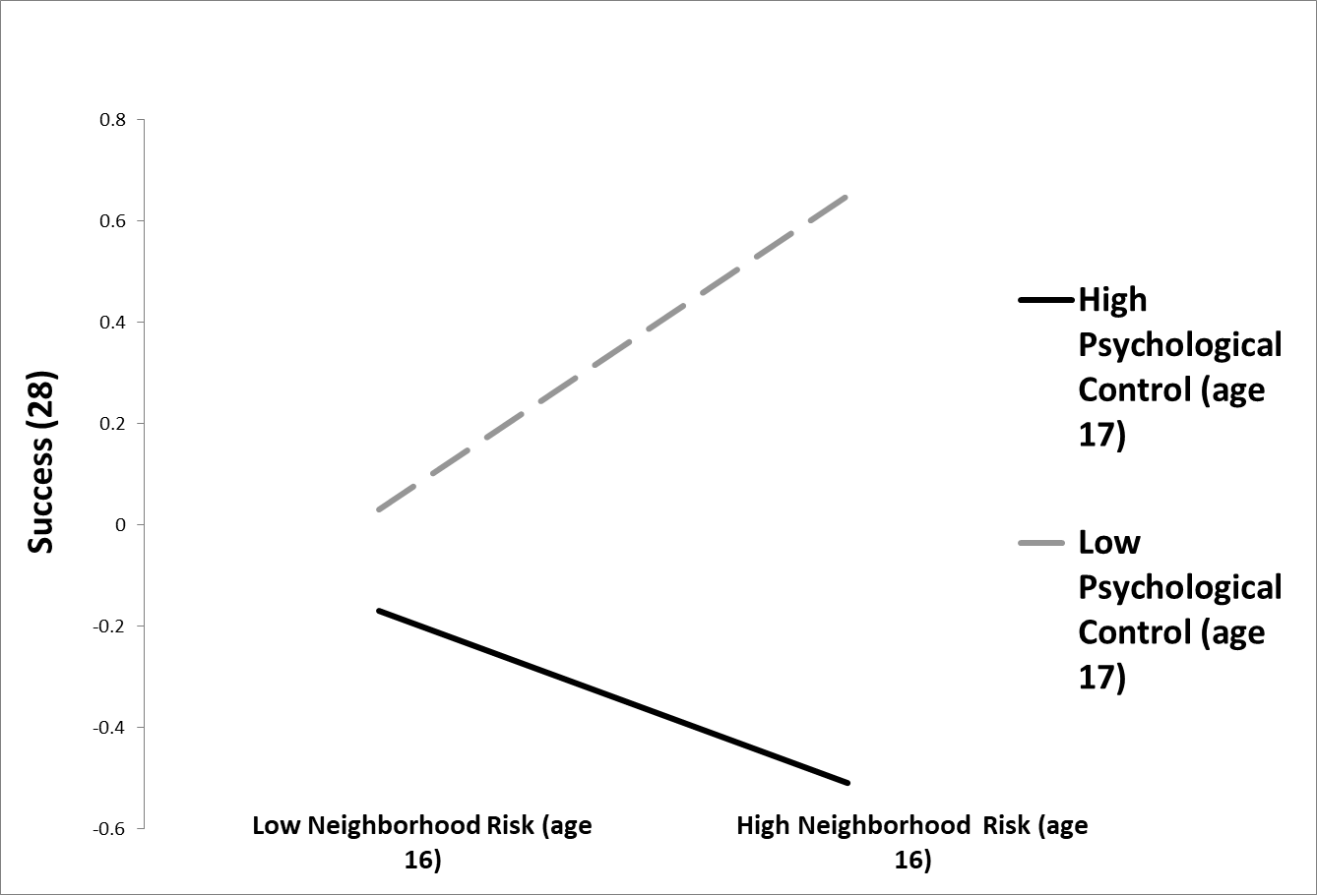
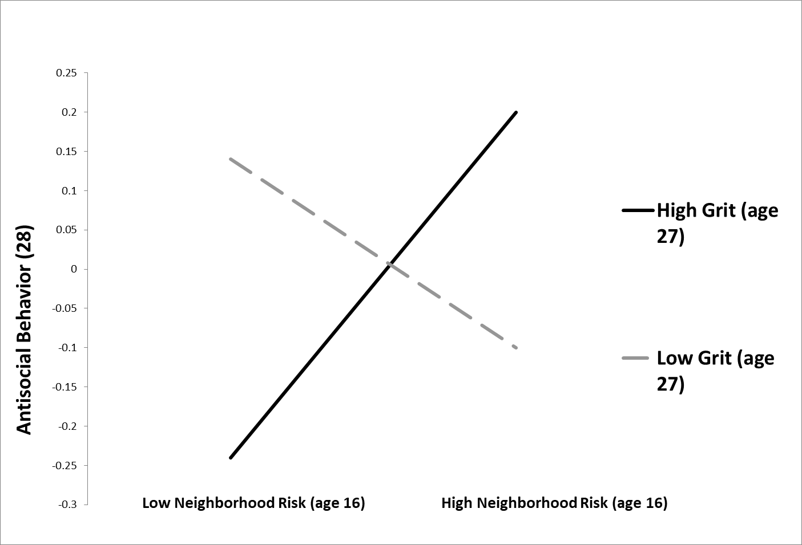
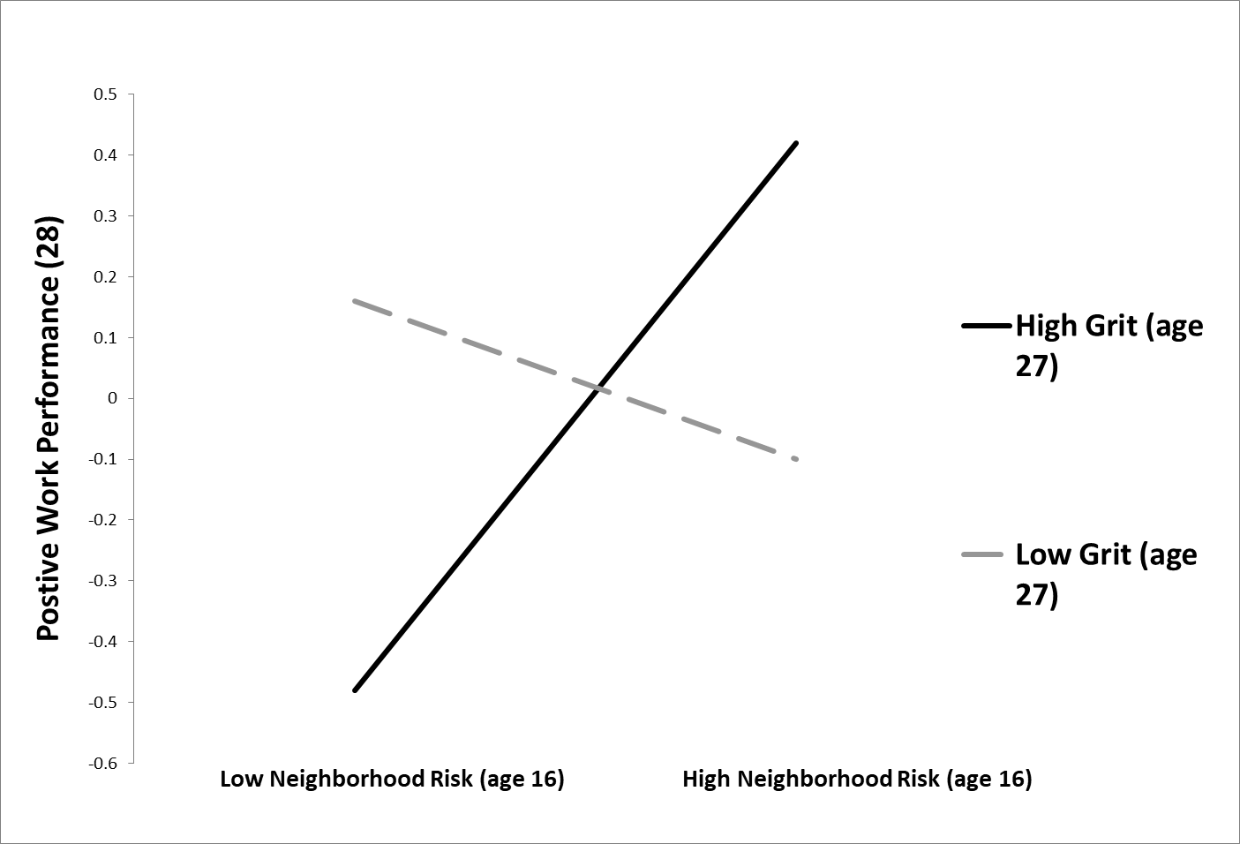
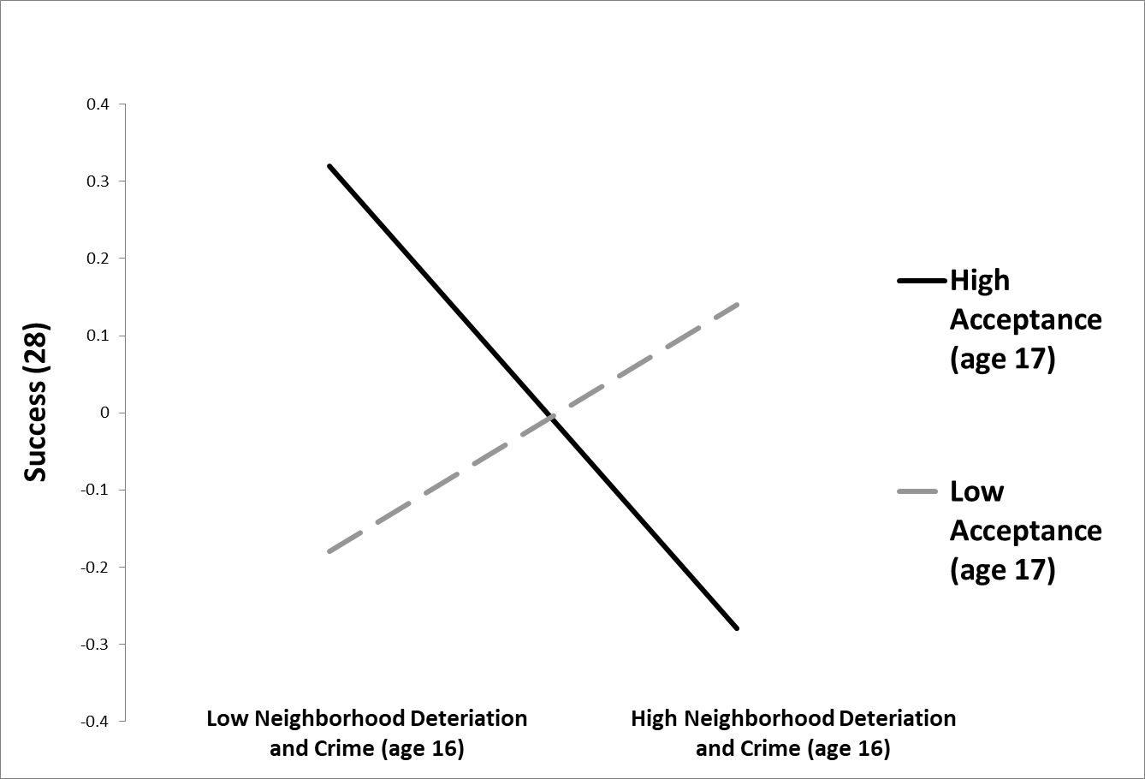
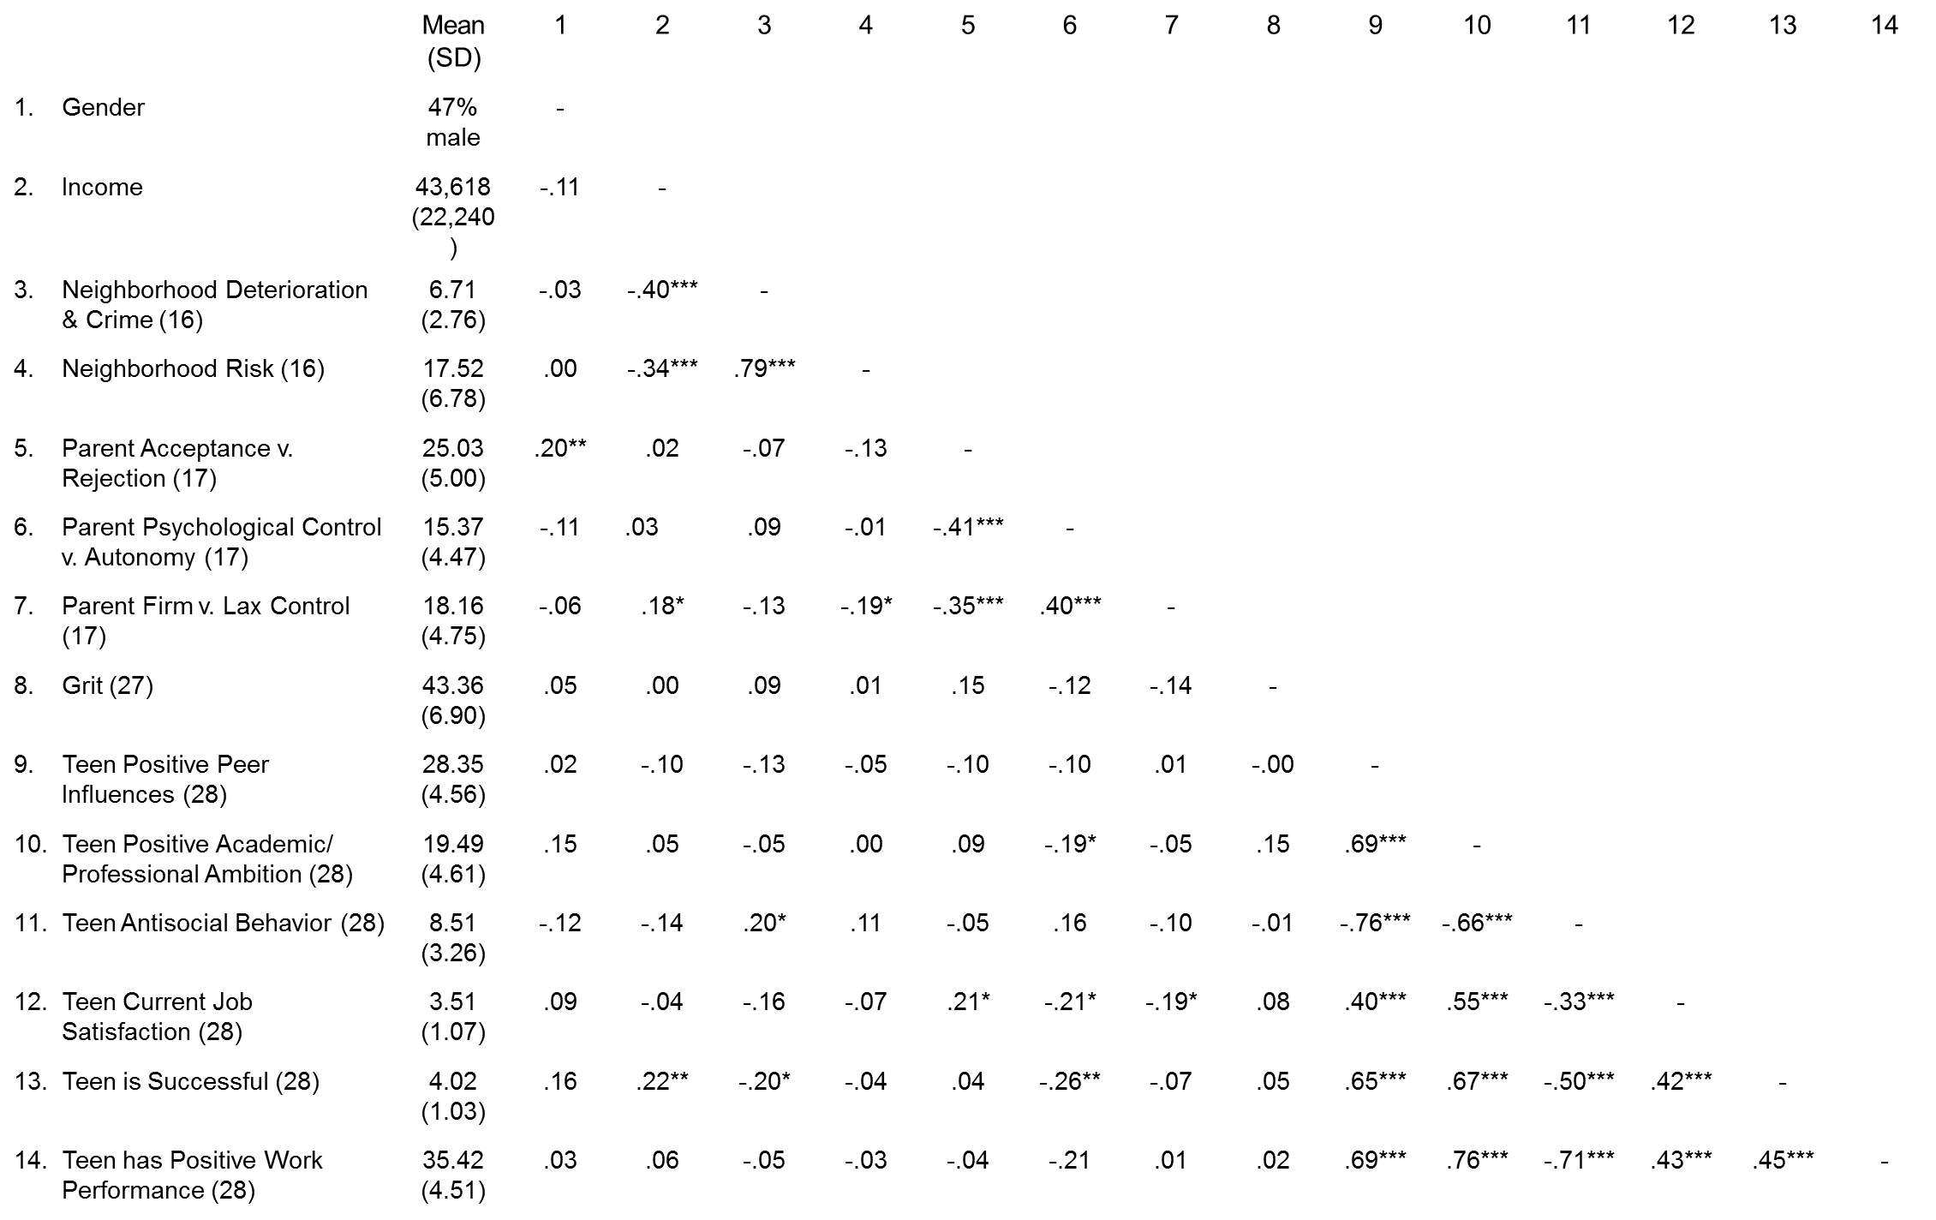
Neighborhood Quality, Parenting Behavior, and Grit: Links to Future Adjustment
(King, Fite, & Poquiz 2017).
Kayla D. Pitchford & David E. Szwedo
James Madison University
Introduction
Grit (age 27) Assessed using the Grit Scale, a 12-item measure of individuals level of perceived grit.
Young Adult Adjustment (age 28) Assessed using the Young Adult Adjustment Scale, comprised of several subscales used to measure various domains of youth’s functioning. Participants peers reported on how they evaluated youth’s transition into adulthood.
Raising a child to be successful is attributed to interactions among child and familial connections and the social environment in which they operate (Sheridan, Cowan, & Meegan, 1999).
The high susceptibility to violence associated with living in unsafe neighborhoods is linked to greater community stress levels and greater exposure to violence for youth, leading to negative affects on youths mental health well-being, behavior, and academics (Foster & Brooks-Gunn, 2009).
Excessively controlling tendencies of authoritarian parents has persistently been linked to future aggression, somatic symptoms disorder, delinquency, anxiety, and depersonalization of children (Kuppens & Ceulemans, 2018).
Children residing in less safe neighborhoods partake in more delinquent activities and attempt to conceal that part of their lives from parents, prompting parents to inquire more often about their child’s whereabouts and instilling more control (King, Fite, & Poquiz 2017) .
Children identified as having a high and persistent future orientation trajectory, both characteristics of grit, have a much higher likelihood of achieving young adult developmental benchmarks (Oshri, Duprey, Kogan, Carlson, & Liu (2018).
The purpose of this study is to investigate how parenting behavior and neighborhood quality effect future young adult adjustment, and if those outcomes can be mediated or moderated by the character trait of grit.
Results
Figure 1.
Figure 2.
Figure 1. Those who live in neighborhoods with high rates of crime and deterioration and have high psychologically controlling parents mature to have the least ambition.
Figure 2. Those who live in neighborhoods with high rates of crime and deterioration and have high psychologically controlling parents mature to have the least number of positive peer influences.
Figure 3. Those who live in high risk neighborhoods and have high psychologically controlling parents mature to be the least successful.
Figure 3.
Heuristic representation of regression analyses predicting young adult adjustment from neighborhood quality subscales, parental behavior, and grit. Lines indicate significant associations between variables.
Regression analyses examined neighborhood quality, parental behavior, and grit in adolescence as predictors of young adult adjustment, controlling for gender and family household income.
Analyses revealed several associations between subscales of parental behavior and adolescent job satisfaction, success, and positive academic and professional ambition as a young adult.
Interaction analyses examined neighborhood quality and parental behavior in adolescence as predictors of young adult adjustment, and if this relationship could be mediated by adolescents level of grit (see Figures 1-6).
Correlations between primary variables are presented in Table 1 below.
Hypotheses
Figure 4.
Figure 5.
Youth living in neighborhoods with a high crime rate and an unhealthy parental relationship will experience more adversity adjusting as a young adult.
Difficulty adjusting may be mediated or moderated by children’s level of grit, suggesting when grit is introduced as a moderator it will protect against the negative effects of parental behavior and neighborhood quality.
Figure 4. Those who live in low risk neighborhoods and have high grit engage in antisocial behavior the least.
Figure 5. Those who live in high risk neighborhoods and have high grit achieve the highest amount of positive work performance.
Figure 6. Those who live in neighborhoods with low rates of crime and deterioration and have highly accepting parents mature to have the most success.
Method
Table 1. Univariate statistics and inter-correlations between primary constructs
Figure 6.
Participants
Full sample from larger study: N = 184
Gender Race/ethnicity Income
86 males 107 Caucasian Median = $40,000 - $59,000
98 females 53 African American
24 Mixed/Other
Discussion
When living in unsafe neighborhoods and when parents are potentially instilling more psychological control on their children, adolescents may retract and rebel by being less ambitious, failing to thrive for success, and interacting with negative peer influences.
Adolescents having high grit and living in low risk neighborhoods, a conducive environment for young adult outcomes, may lead them to have a very positive outlook towards the future, prompting them to engage in less antisocial behavior.
Living in high risk neighborhoods and having high levels of grit contribute to the highest positive work performance, even higher than adolescents who reside in low risk neighborhoods.
Although having accepting parents is usually perceived as a positive attribute, in the instance of living in unsafe neighborhoods adolescents may be engaging in delinquency, and if so, parents being accepting potentially are condoning these negative behaviors.
Measures
Neighborhood Quality (age 16) Assessed using the 16-item Neighborhood Quality Questionnaire. Participants’ mothers self reported their satisfaction with various aspects about the family's neighborhood.
Parental Relationship (age 17) Assessed using the 30-item Childhood Report of Parenting Behavior Inventory (CRPBI). Participants self-reported on three dimensions of their parent-child relationship including: acceptance versus rejection, psychological control versus autonomy, and firm versus lax control.
Note. * p ≤ .05, ** p ≤ .01, *** p ≤ .001

