Slide 1
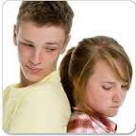
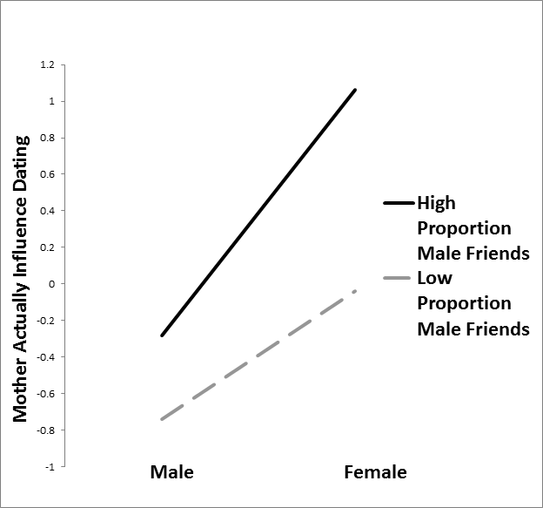
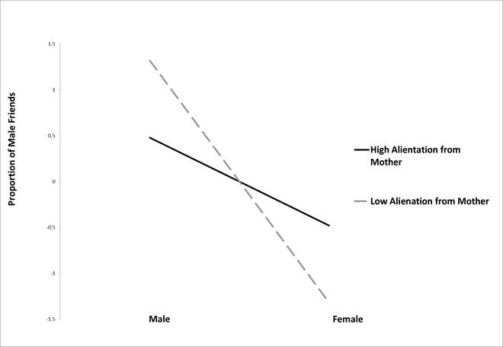
Relationship Between Adolescent Male Peer Friendships, Maternal Alienation, and Mother’s Influence On Teen Dating
Emily Severt¹, David E. Szwedo¹, & Joseph P. Allen²
¹James Madison University
²University of Virginia
David E. Szwedo
dszwedo@virginia.edu
Emily B. Severt
severteb@dukes.jmu.edu
Introduction
Measures:
Concentric Circles Gender of Peers– (Teen Age, 13) Assessed the gender of the teen, and the gender of up to 12 peers listed on the teen's concentric circle. It also gave the total # of boys, total # of girls, total # of peers listed, the proportion of girls and the proportion of boys in each teen's concentric circle.
Peer/ Parent Influences Questionnaire– (Teen Age, 13) Assessed the amount of actual influence mothers have on teens. Specifically for this study, the amount of actual influence mothers have on teen’s dating relationships.
Inventory of Parent and Peer Attachment – (Teen Age, 13) Assessed the teen’s report of attachment to mother. Higher scores indicated greater alienation between teen and mother.
Secure parental attachment has long been associated with better life outcomes (Armsden & Greenberg, 1987).
Parental attachment is said to be an influencing factor in a child’s formation of peer relationships (Schneider, Atkinson, & Tardif, 2001).
Connections between an adolescence’s parent, peer, and the romantic relationships have been indicated (Furman & Shomaker, 2008).
Research suggests more secure attachments exist with mothers as opposed to fathers (Doyle, Lawford, & Markiewicz, 2009).
Gender differences indicate that peer relationships between same-sex friends continue to be stable over time; however, opposite sex friends become increasingly more influential- especially for girls (Richards, Crowe, Larson, & Swarr, 1998).
Results
Hypotheses
With regards to dating, mothers will have a stronger influence on daughters than sons.
Mothers influence will be less significant if teen feels more alienated from their mother.
Connections between an adolescence’s parent, peer, and the romantic relationships have been indicated (Furman & Shomaker, 2008).
Mothers will have a stronger influence on teen dating when teen has a higher portion of male friends.
Higher alienation from mothers will predict a lower proportion of male friends for males, but a higher proportion of male friends for females.
Figure 2. The relationship between mother’s actual influence on teen dating and adolescents proportion of male friends, as related to adolescent’s gender. Note. * p ≤ .05, ** p ≤ .01, *** p ≤ .001
Discussion
Alienation from mothers may elicit different socializing behaviors for both males and females.
Less alienated mothers may encourage positive socializing behaviors that are more more in line with societal beliefs (i.e. males should have more male friendships, while females should have less male friendships and more female friendships).
Mother’s have greater influence on teen’s dating when their teen has a higher proportion of male friends.
Mothers are more concerned when their daughters have a high proportion of male friends, and thus exhibit significantly more influence on female dating.
Method
Participants
Full sample from larger study: N = 184
Gender Race/ethnicity Income
85 ma
les 107 Caucasian Median = $40,000 - $59,000
99 females 53 African American
24 Mixed/Other
Figure 1. The relationship between the amount of alienation felt from mothers and the proportion of male friendships adolescents have, as related to adolescent's gender. Note. * p ≤ .05, ** p ≤ .01, *** p ≤ .001
Notes:
1

